Slide 1



PROJECT
PLANNING
The Basics of Capital and Reserve Projects

Slide 2

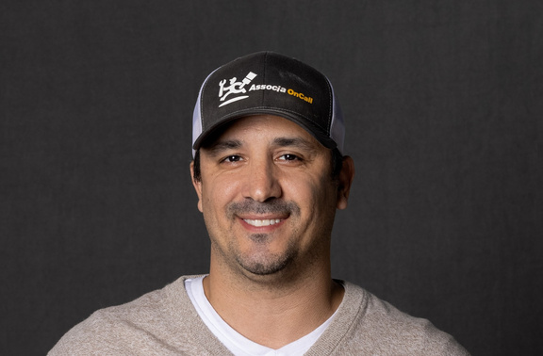
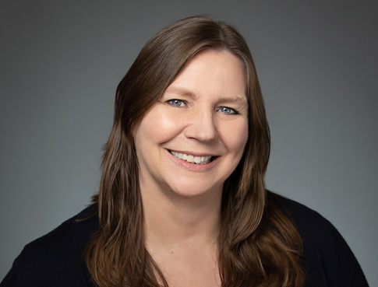
PRESENTERS
JOSH PORTER
Josh has been working with communities for over a decade in the PNW. His team has successfully conducted large-scale upgrades and replacement projects for our clients. He holds his General Contractor’s license in OR and WA.
CAREN FEWELL
Caren serves as the Branch President for Blue Mountain. She has been in the HOA industry for 25 years and has extensive experience with a wide variety of capital and reserve projects. She holds her PCAM designation as well as her General Contractor’s License.

Slide 3




TYPES OF PROJECTS
CAPITAL
RESERVE
EMERGENCY
New additions
Repair or replacement of existing components
Unforeseen events

Slide 4

CAPITAL PROJECTS
  Improvement Projects
  Cannot be funded through reserves
  Funding may come from:
    Operating funds
    Working Capital
    Special Assessment

Slide 5
RESERVE PROJECTS
REPAIR
REPLACEMENT
Major repairs (not routine)
Examples: Roofing repairs to more than one unit; landscape refurbishment
Complete replacement
Can include upgrading

Slide 6





STEPS OF A PROJECT
These steps refer to either Capital or Reserve projects
RFP PROCESS (INCLUDING BID WALK AND COMPARING BIDS)
IDENTIFY THE PROJECT/CREATE SCOPE OF WORK
NEGOTIATE/SELECT VENDOR
SCHEDULE PROJECT
COMMUNICATE

Slide 7

STEP ONE: IDENTIFY THE PROJECT
REQUESTS
PLAN
RESERVE STUDY
Is this capital or reserve?
Where is the funding coming from?
If it’s a replacement, are we replacing like or like, or upgrading?
FUNDING
ENHANCEMENT

Slide 8





STEP TWO: SCOPE OF WORK
GENERAL CONTRACTOR
SPECIALIST
CONSULTANT
NOT THE MANAGER

Slide 9

STEP THREE: REQUEST FOR PROPOSAL
This is a formal process that spells out the scope of work and any other specific details such as timing, etc. This allows bids to be comparable.

Slide 10


STEP FOUR: BID WALK OR QUESTIONS
WALK WITH ALL BIDDERS
ANSWER QUESTIONS
EVEN PLAYING FIELD
ACCURATE INFO

Slide 11
STEP FIVE: COMPARE BIDS
1
2
3
4
CONTRACT PRICE
MATERIALS
WARRANTY
TIMING
Be sure that materials are included in the bid, and that the type of materials is what was specified in the RFP.
Look at the warranty and compare between bids. If you are using a General Contractor, ask about double warranty (GC and subs).
Does the timing fit with what the Board is looking for? A lower price may mean waiting longer for the project to start or conclude.
The lowest bidder may not be the best bid. Price should be a consideration, but not the only one.
Negotiate if needed - if one item is off but the rest of the bid is great, talk to them!

Slide 12

STEP SIX: SELECT VENDOR/SIGN CONTRACT
When should your attorney review a contract?
Who can sign a contract? (hint: this should not be your manager!)

Slide 13

STEP SEVEN: SCHEDULE THE WORK
A general contractor can be very helpful here!
If your manager is scheduling, it is most likely an extra charge.

Slide 14


STEP EIGHT: COMMUNICATE
Make sure everyone knows what’s happening!
  Post on portal
  Signs on bulletin boards or mailboxes
  Doorhangers
  Email blast

Slide 15
WHAT ABOUT EMERGENCIES?
1
2
3
4
HANDLE IMMEDIATE ISSUE
EVALUATE
INSURANCE?
FOLLOW STEPS
Do you have time to get bids, or is the unit/space unsafe or unlivable?
If this is an insurable loss, don’t wait to contact the insurance agent.
Once the emergency portion is handled, follow steps for bids/contracts to finish the repair.
Stop water flowing, mitigate safety issues

Slide 16

THANK YOU!
Contact us if you have more questions!
josh@bluemountaincommunity.com
caren@bluemountaincommunity.com

